Slide 1
Single-Cycle ARM Processor Design
2nd Term Project
Kyung Min Kim
E-mail: kyoungmin2@naver.com
SoC & Microprocessor Research Laboratory

Slide 2
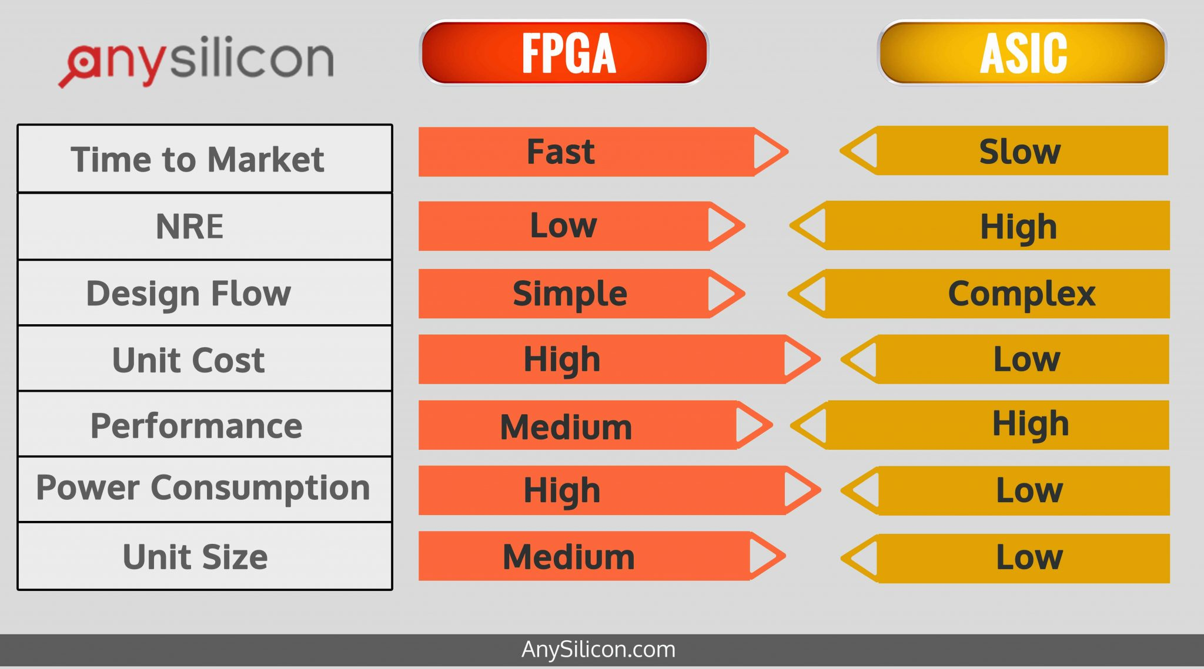
FPGA vs ASIC
Reference: https://anysilicon.com/fpga-vs-asic-choose/

Slide 3
Design Flow
Functional Specification
HDL
Functional Specification
Behavioral Simulation
Synthesis
HDL
Static Timing Analysis
Behavioral Simulation
Synthesis
Equivalency Checking
Place & Route
Place & Route
Static Timing Analysis
Static Timing Analysis
Download and Verify in Circuit
Equivalency Checking
Verification of 2nd & 3rd Order Effects
Verify in Circuit
FPGA
ASIC

Slide 4
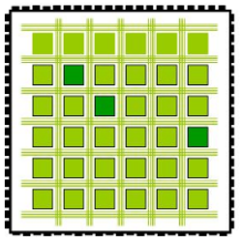
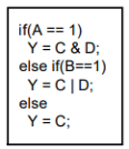
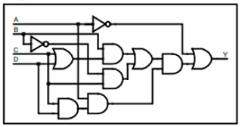
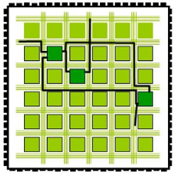
Synthesis and Place & Route (FPGA)
Place
Synthesis
P & R
HDL
Netlist of Logic Gates
Route
Synthesis: The process of making a circuit written in Verilog HDL or VHDL into a netlist of logic gates
Place & Route: As implied by the name, it is composed of two steps, placement and routing. The first step, placement, involves deciding where to place all electronic components, circuitry, and logic elements in a generally limited amount of space. This is followed by routing, which decides the exact design of all the wires needed to connect the placed components. This step must implement all the desired connections while following the rules and limitations of the manufacturing process.

Slide 5
Overview
Instruction Analysis
Control Signal Analysis
Module Implementation
1st Term Project
2nd Term Project

Slide 6
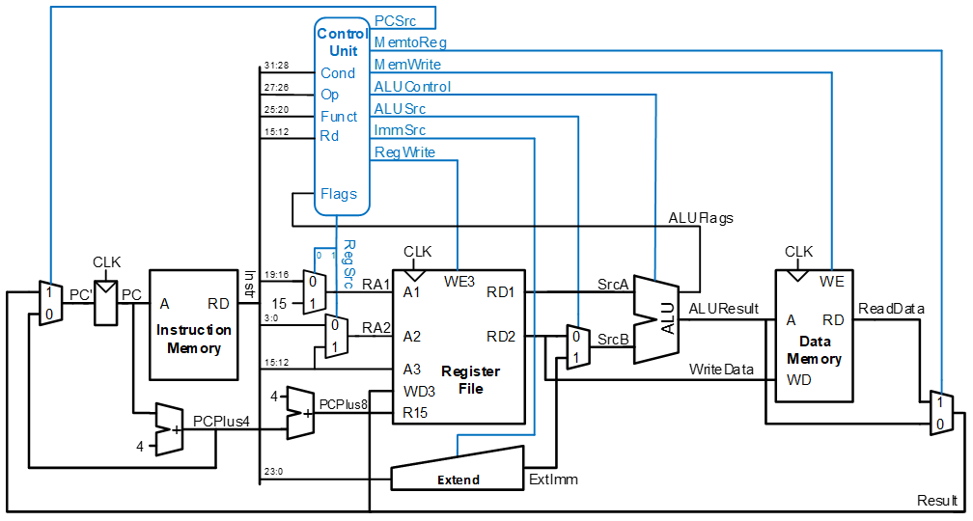
Overview

Slide 7
Overview
Given processor is able to run following instructions
Branch : B, BL
Arithmetic : ADD, SUB, CMP, MOV
Load/Store : LDR, STR
Given processor is able to run following suffixes
Logical : EQ, NE (‘Z’ in ‘NZCV’)
Addressing Modes
Addressing Mode 1 : 1 (immediate), 2 (register)
Addressing Mode 2 : 1 (immediate offset), 2 (register offset)

Slide 8
Overview
Clock
2)
4)
1)
3)
5)
6)
1 Clock Cycle
Clock 0: blue, Clock 90: red
(Clock 0 and Clock 90 connected memory and register, in respectively)
1) Instruction fetch (Clock 0’s posedge)
2) Check condition code & Initialize control signal
3) Register read (Clock 90’s posedge)
4) ALU
After ALU operation: Update NZCV
5) Memory read / write (Clock 0’s negedge)
6) Register write (Clock 90’s negedge)

Slide 9
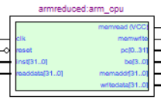
Module
ARMProcessor module
Input
clk : Clock 90
reset : reset if press return button
inst[31:0] : current instruction
readdata : data from memory
Output
pc : instruction address (starting at 0)
be[3:0] : 1111(2) (default) – don’t change!
memaddr[31:0] : data address
memread : 1(2) (default) – don’t change!
memwrite : specify whether memory is to be written
writedata[31:0] : write data to memory

Slide 10
Module
RegisterFile Module
Register 14 ($14) – Link Register (LR)
This register holds the address of the next instruction after a Branch and Link instruction
$14 = PC + 4
Register 15 ($15)
It can be used in most instructions as a pointer to the instruction which is two instructions after the instruction being executed
$15 = PC + 8
PC (It is different with Register 15($15))
PC (next instruction) = PC (current instruction) + 4

Slide 11
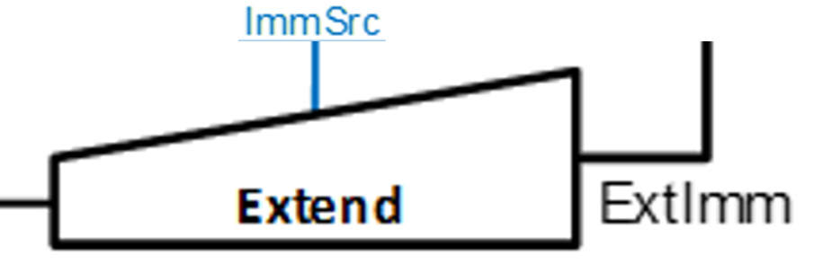
Module
Extend Module
Data Processing Type: zero extended-imm8
0000/1010(2) -> 0000/0000/0000/0000/0000/0000/0000/1010(2)
Load/Store Type: zero extended-imm12
0000/1010/0000(2) -> 0000/0000/0000/0000/0000/0000/1010/0000(2)
Branch Type: sign-extended-imm24, shifting left two bits
1000/0000/0000/0000/1010/0000(2) -> 1111/1110/0000/0000/0000/0010/1000/0000(2)
0000/0000/0000/0000/1010/0000(2) -> 0000/0000/0000/0000/0000/0010/1000/0000(2)

Slide 12
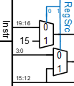
Control signal
RegSrc
RegSrc[0] = “0” : ADD, SUB, CMP, MOV, LDR, STR
Using Register[inst(19:16)]
RegSrc[0] = “1” : B, BL
Using Register[15] for calculating branch target address

Slide 13
Tutorial 1
Programming the DE2 board
http://youtu.be/bg3h7uU_p6U

Slide 14
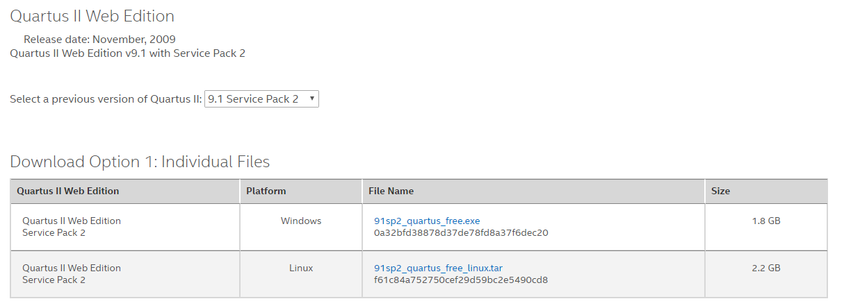
Tutorial 1
Install Quartus2 9.1sp2 Web Edition
Official Website: https://www.altera.com/downloads/software/quartus-ii-we/91sp2.html
Google Drive: https://drive.google.com/open?id=1fmDbWMtaFuT1wJu_11-Jd31gp3Rsm1gp

Slide 15
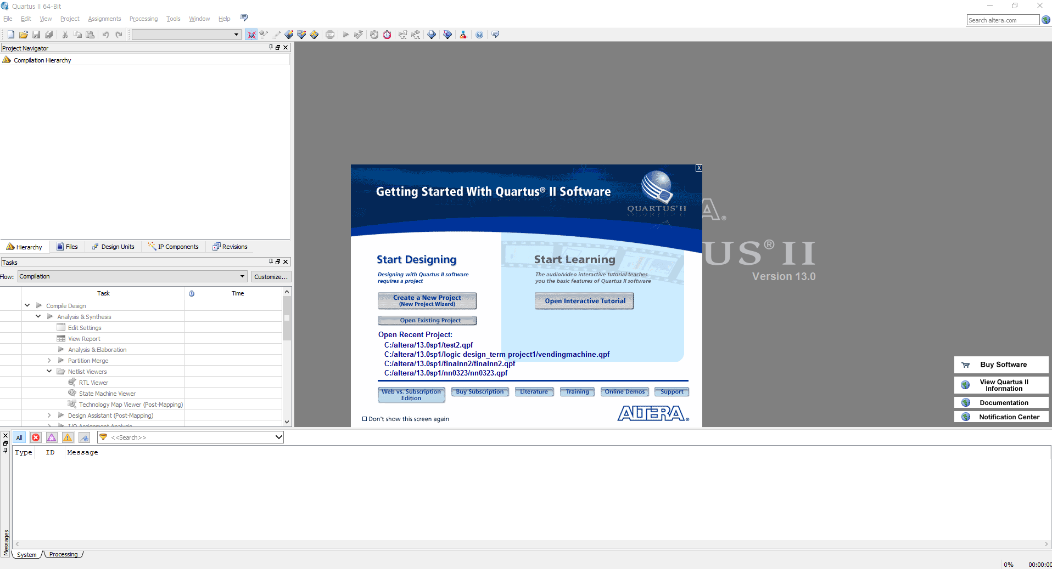
Tutorial 1
How to use

Slide 16
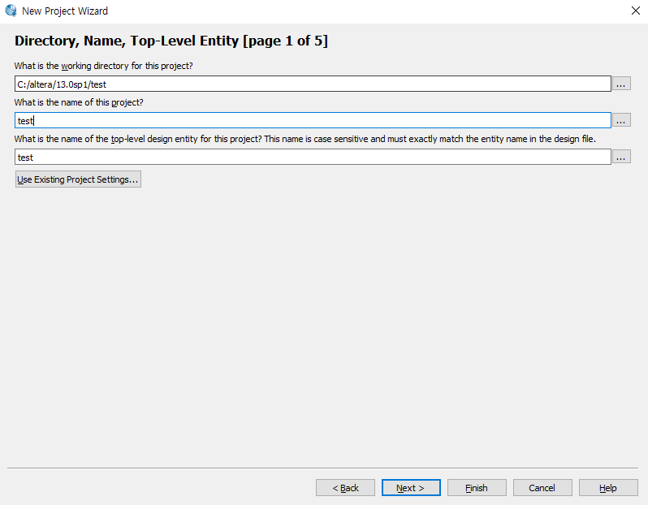
Tutorial 1
How to use

Slide 17
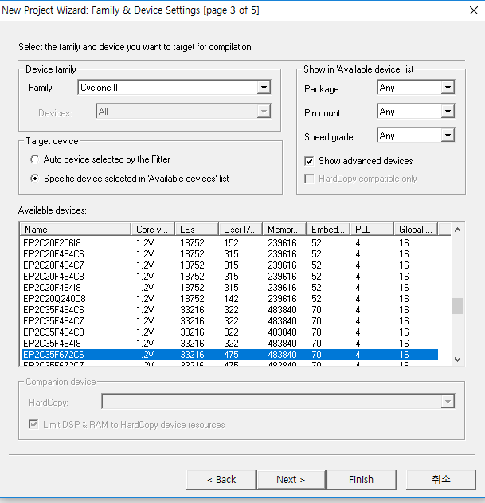
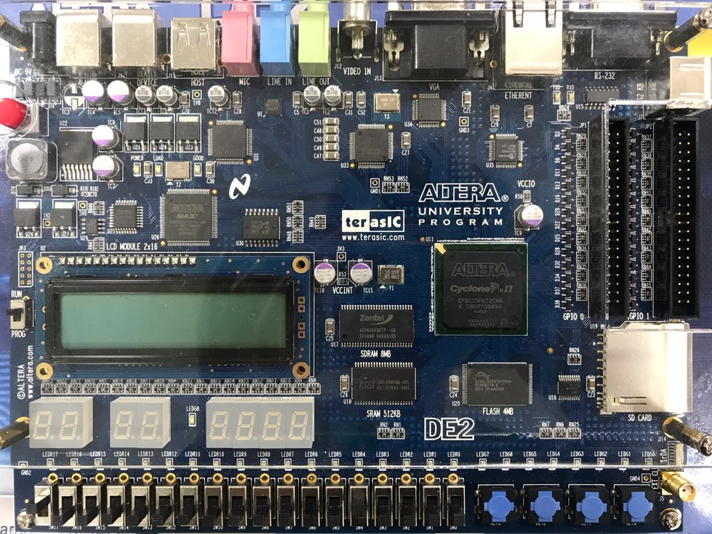
Tutorial 1
How to use
You need to set the device number of the board you have received
Please check the device number because devices can have different numbers

Slide 18
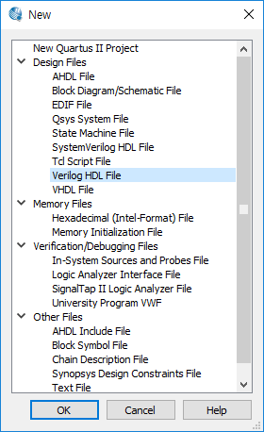
Tutorial 1
How to use
File → New → Verilog HDL File → OK

Slide 19
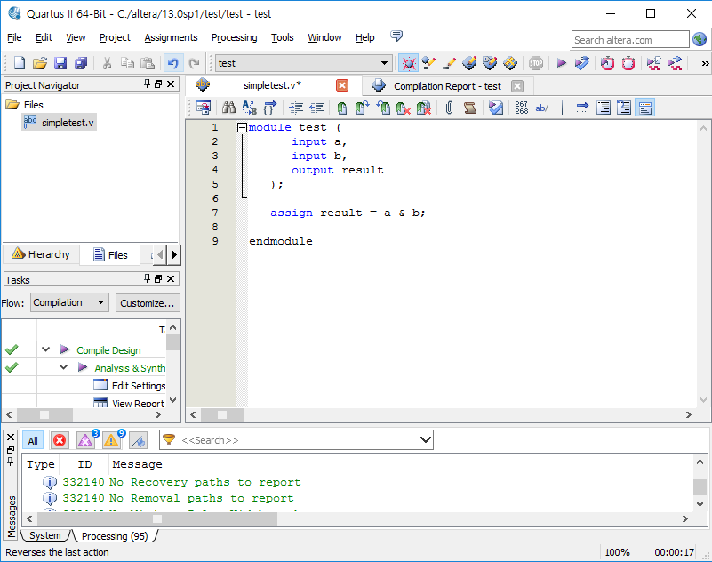
Tutorial 1
How to use
Start Compilation
Same to project name!!

Slide 20
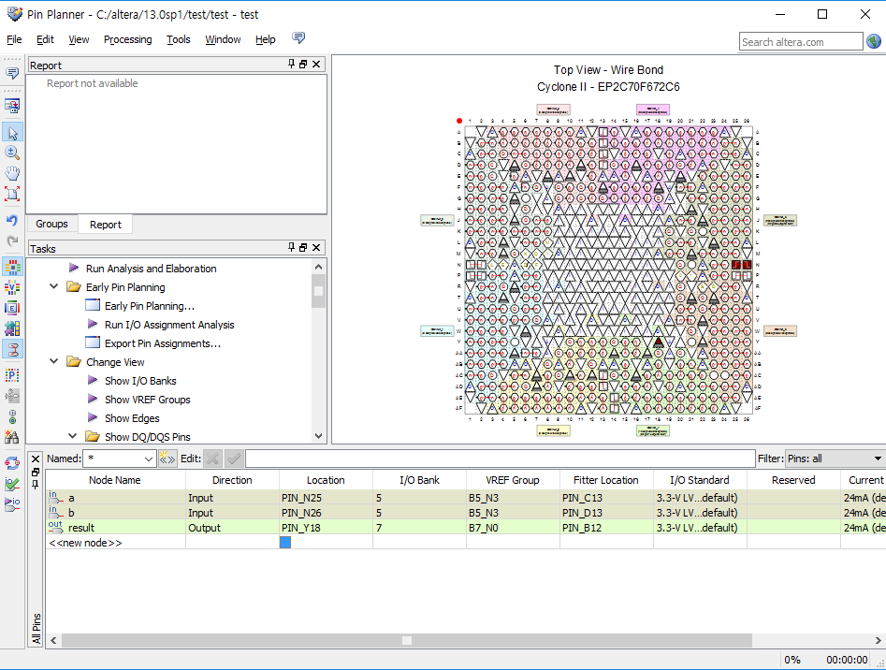
Tutorial 1
How to use
Assignments → Pin Planner → View -> All pins list -> “Fill in the Location” → “Close Pin Planner” → Start compilation
Refer to the attached file “DE2_Pin_Table”

Slide 21
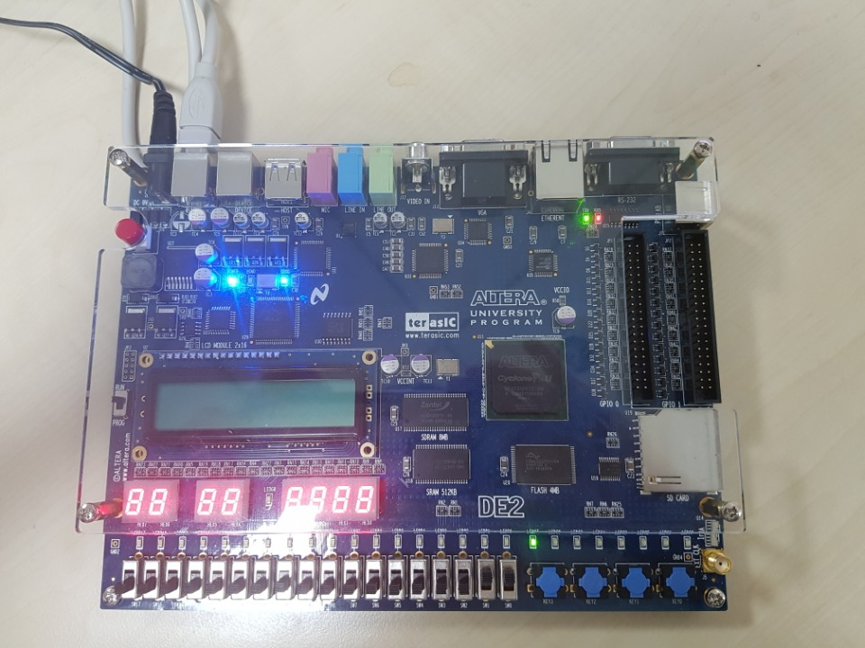
Tutorial 1
How to use
Power USB
Button

Slide 22
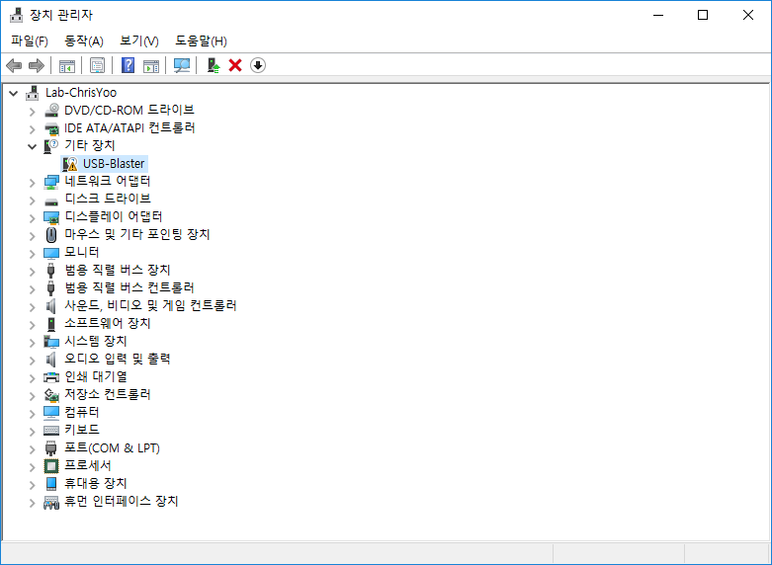
Tutorial 1
Install Driver (Windows 7/8)
“Connect USB & Turn on FPGA“ → 장치 관리자 → “Right click on USB-Blaster” → Install driver software

Slide 23
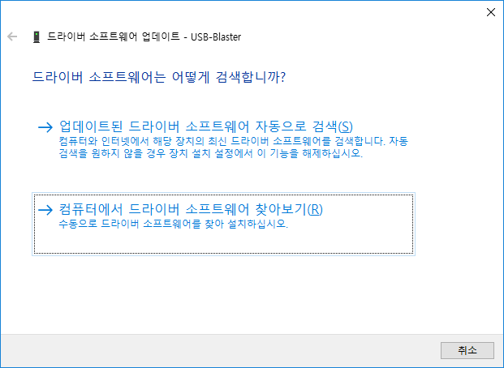
Tutorial 1
Install Driver (Windows 7/8)
“Click Browse” → <Path to Quartus installation>/drivers/usb-blaster directory

Slide 24
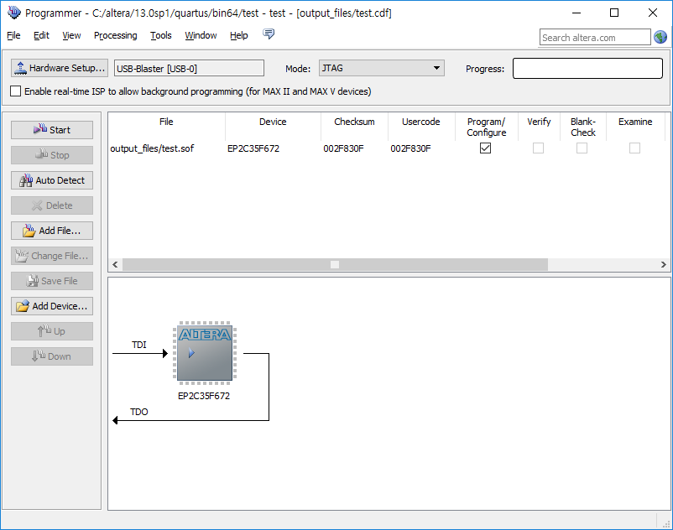
Tutorial 1
How to use
Tools → Programmer

Slide 25
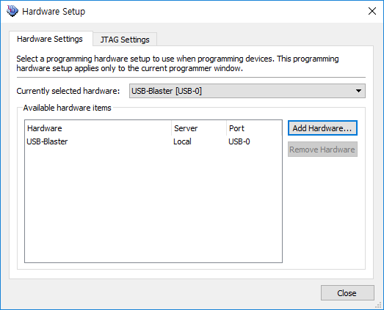
Tutorial 1
How to use
Tools → Programmer

Slide 26
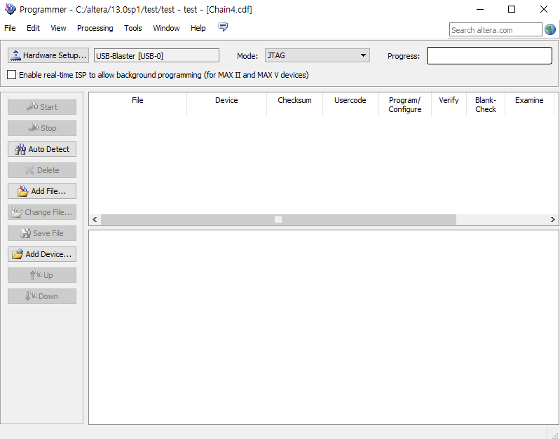
Tutorial 1
How to use
Tools → Programmer

Slide 27
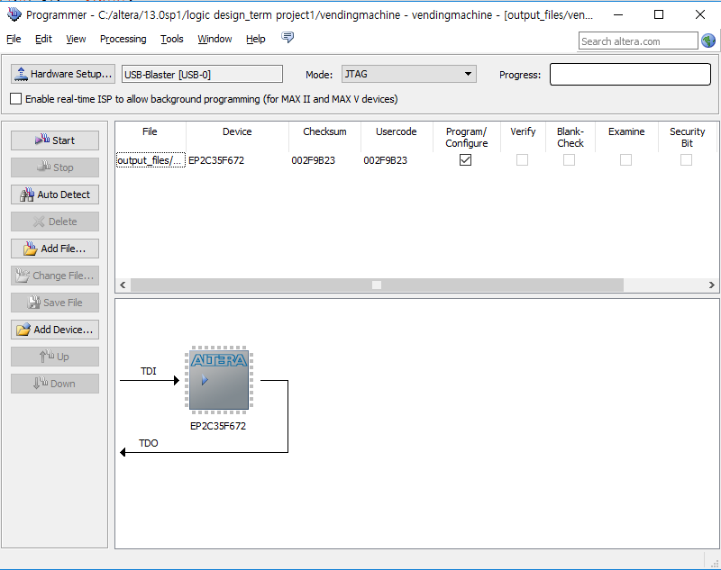
Tutorial 1
How to use

Slide 28
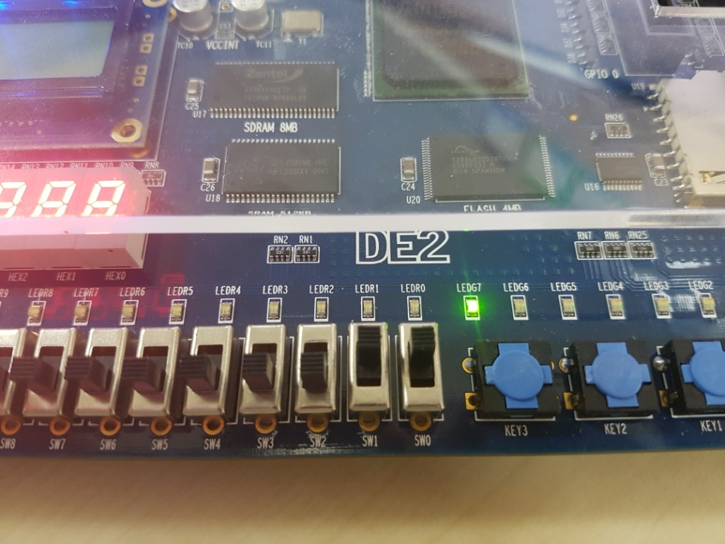
Tutorial 1
How to use
If you do not see the light when you turn up the two switches as shown in the picture below, please send an e-mail to TA (kyoungmin2@naver.com) until 11/4

Slide 29
Tutorial 2
Timing Simulation

Slide 30
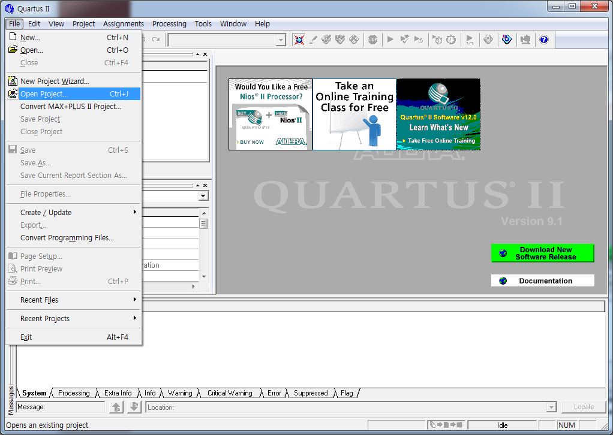
Tutorial 2

Slide 31
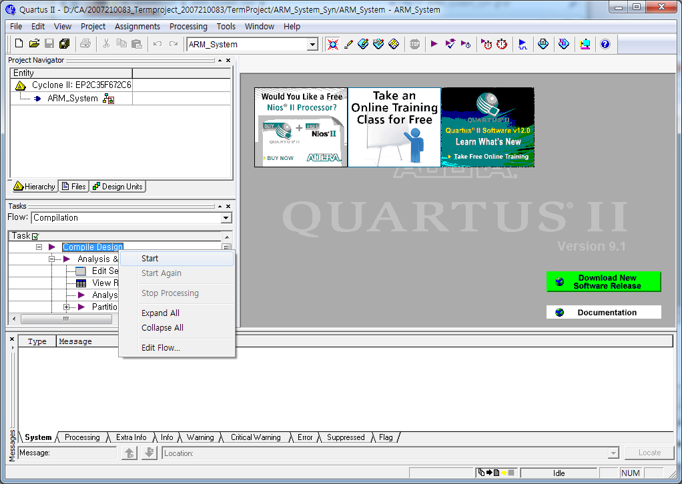
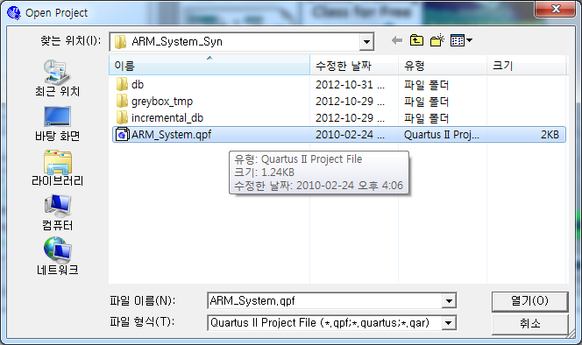
Tutorial 2
1
Click !
2
Click !
Click !
3

Slide 32
Tutorial 2
1
Right Click !
2
Click !

Slide 33
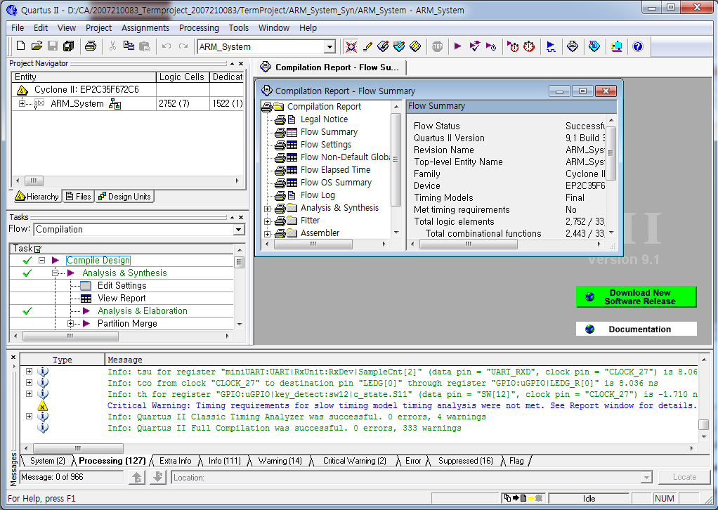
Tutorial 2
Check !

Slide 34
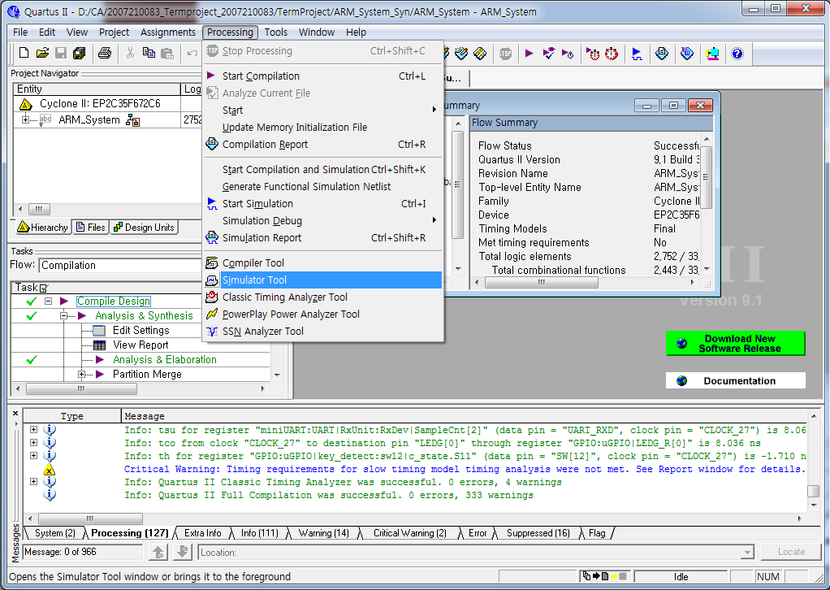
Tutorial 2
1
Click !
2
Click !

Slide 35
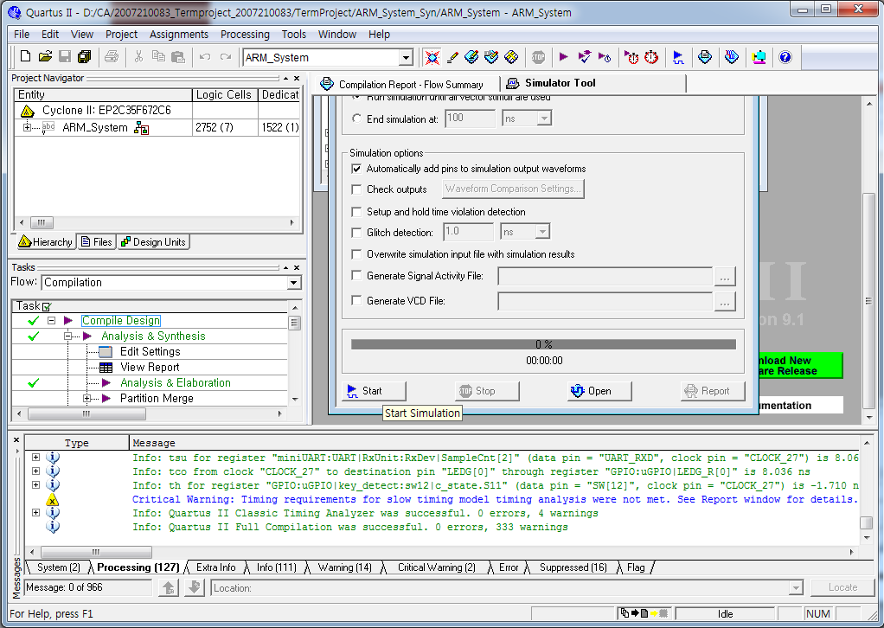
Tutorial 2
Click !

Slide 36
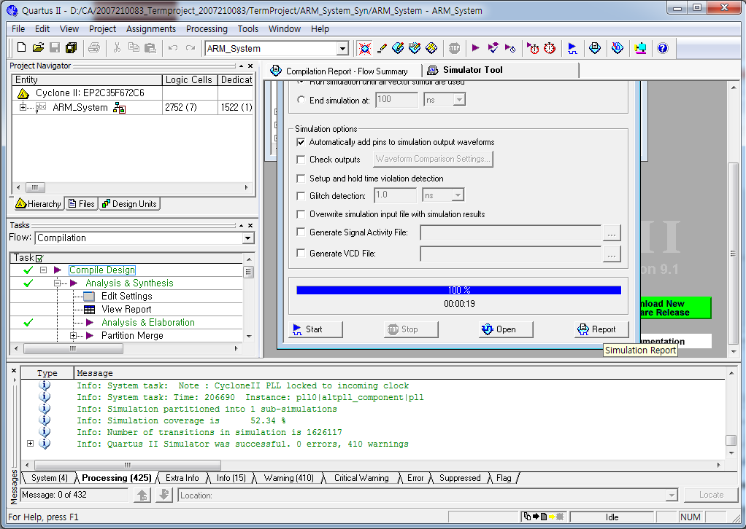
Tutorial 2
Click !
Check !

Slide 37
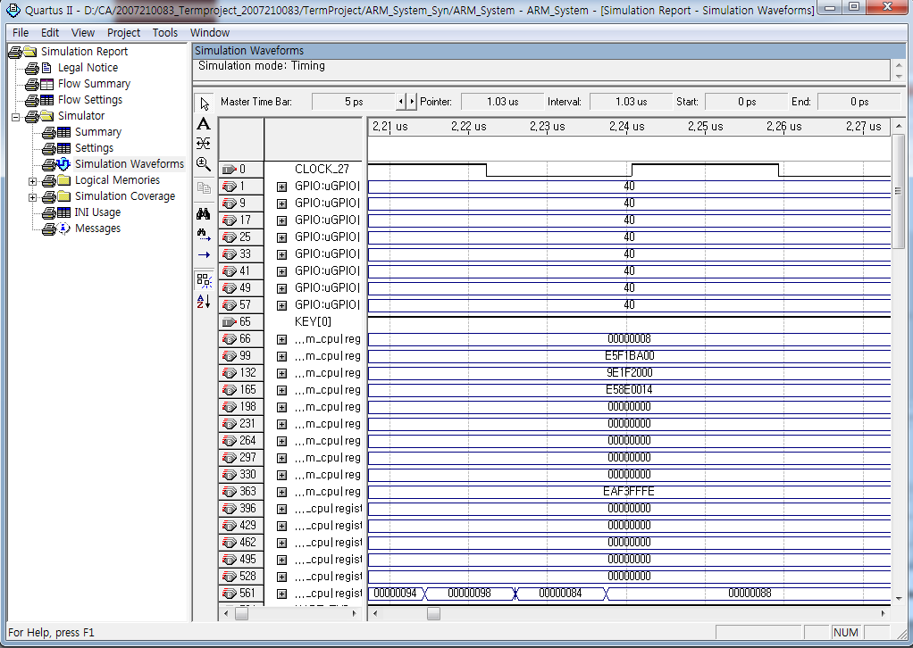
Tutorial 2
Timing Simulation Result

Slide 38
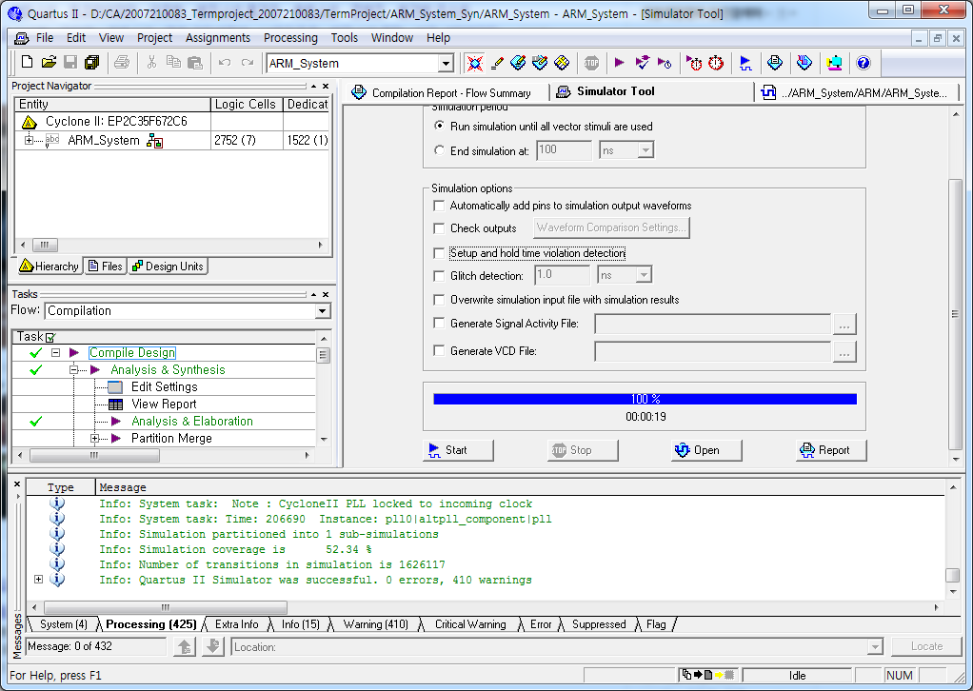
Tutorial 2
Click !

Slide 39
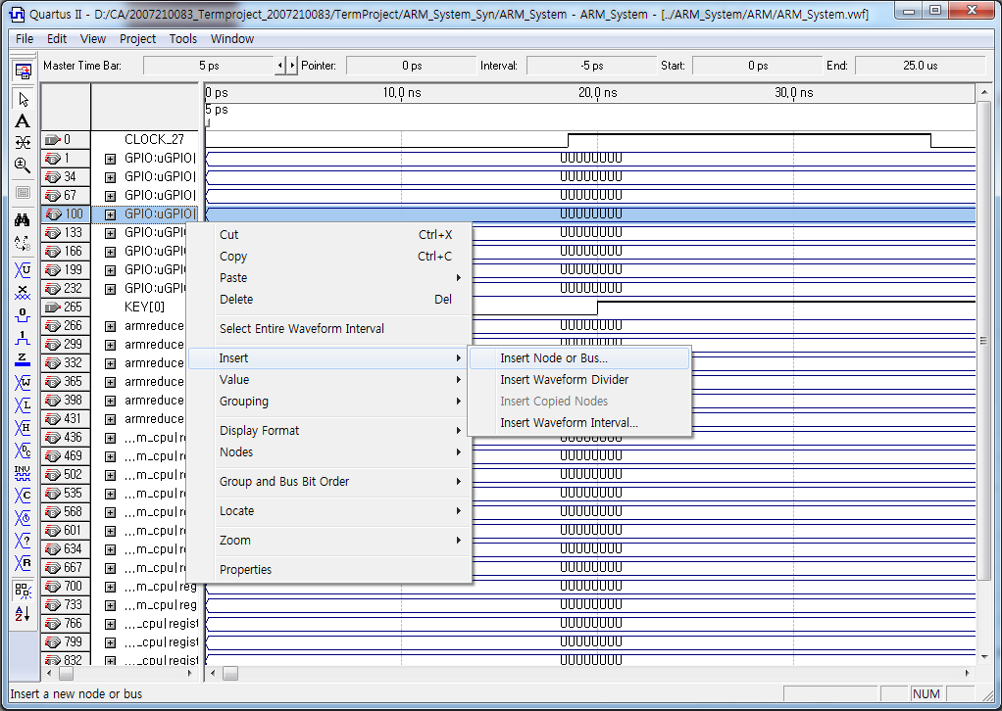
Tutorial 2
Right Click !
Click !

Slide 40
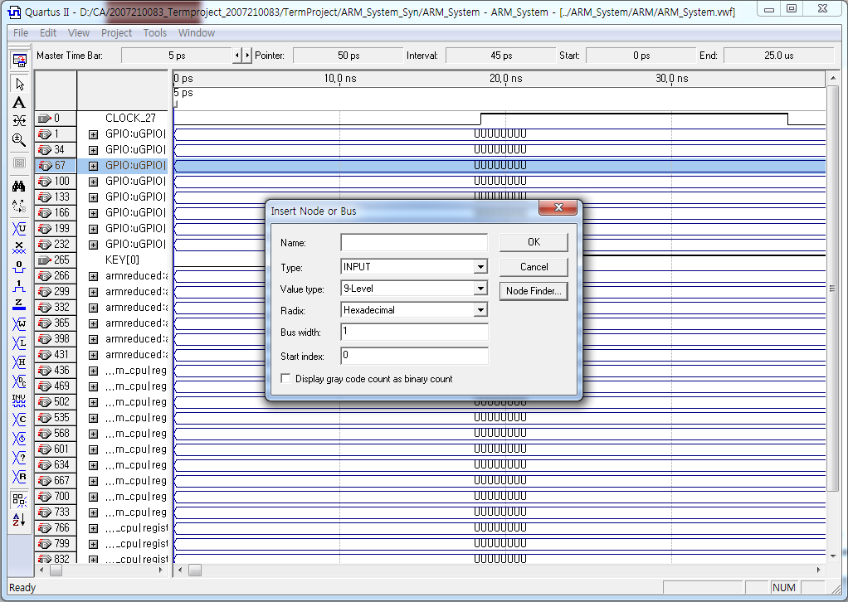
Tutorial 2
Click !

Slide 41
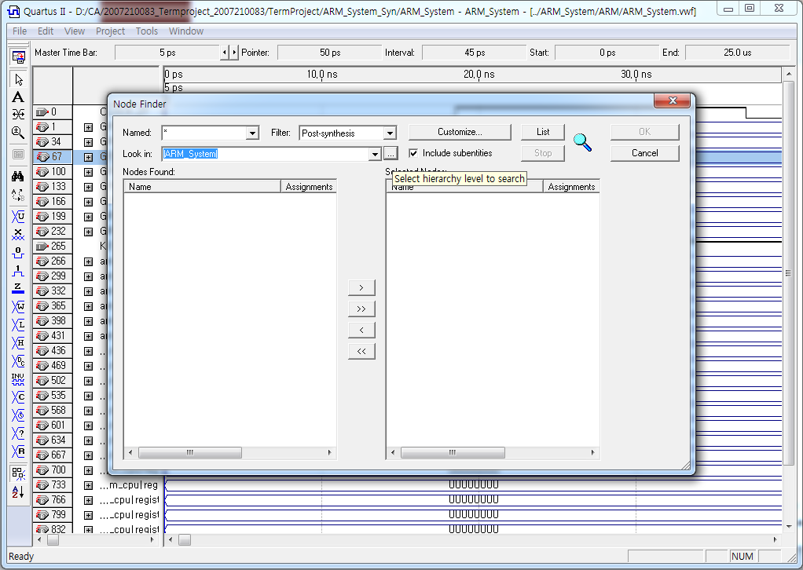
Tutorial 2
Click !

Slide 42
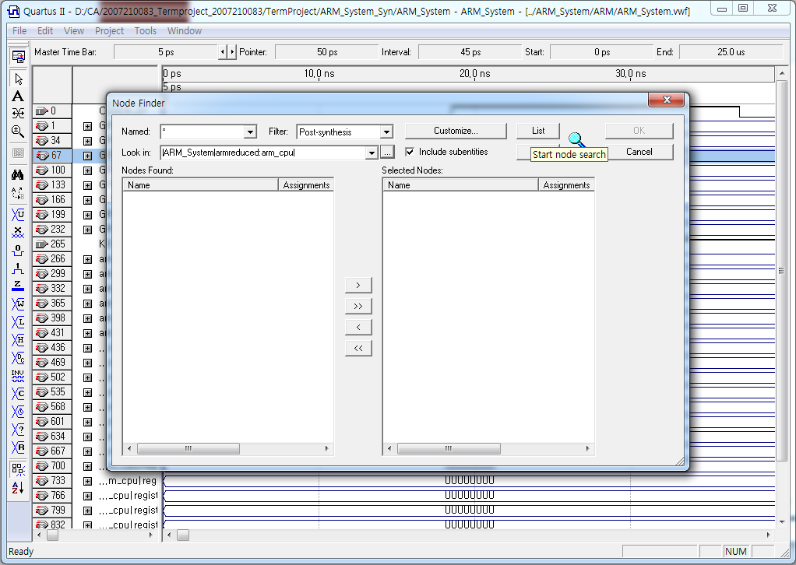
Tutorial 2
Click !

Slide 43
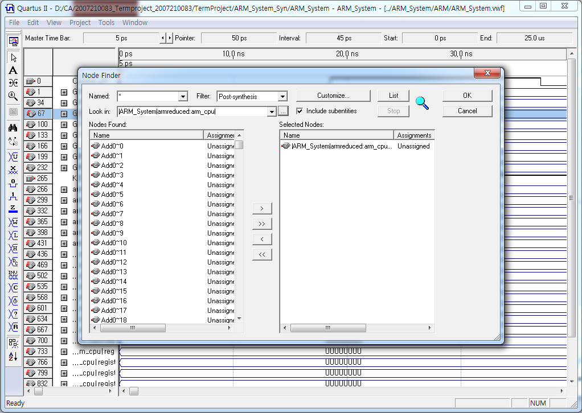
Tutorial 2
Click !

Slide 44
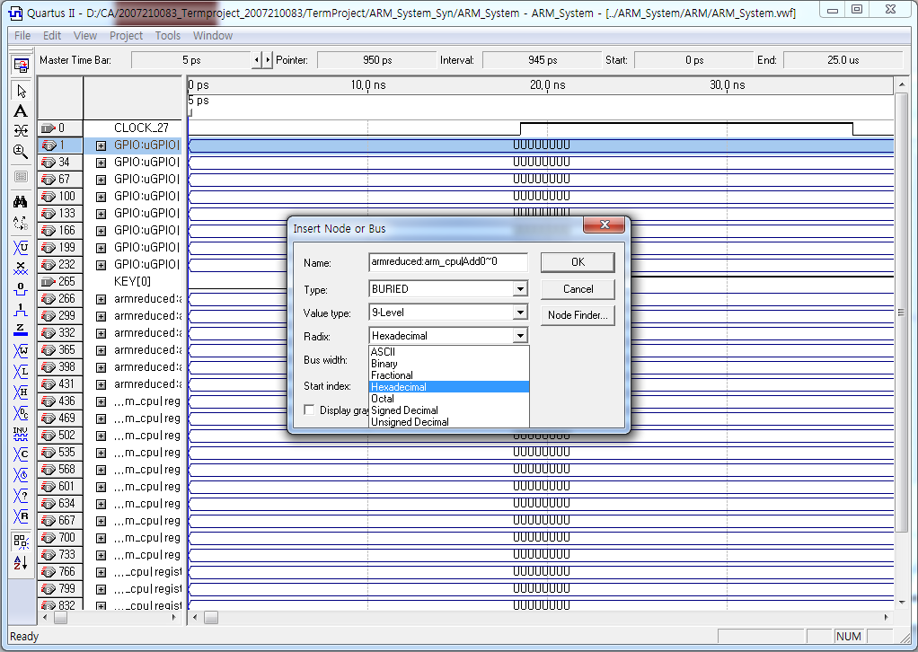
Tutorial 2
Click !
Select the radix

Slide 45
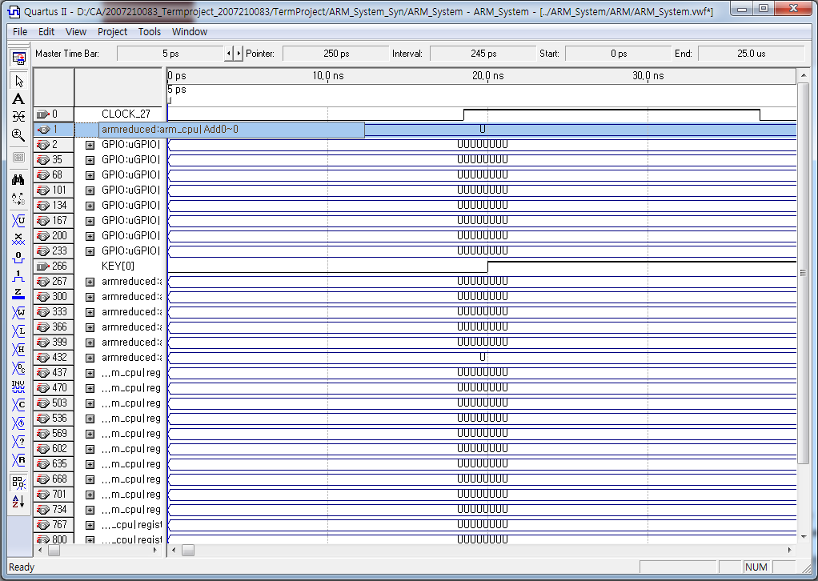
Tutorial 2
Success

Slide 46
Tutorial 3
2nd Term Project

Slide 47
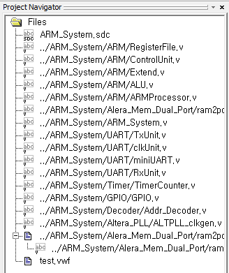
Tutorial 3
CA_2018_2_term -> ARM_System_Syn -> ARM_System.qpf
Coding 5 modules (‘RegisterFile.v’, ‘ControlUnit.v’, ‘Extend.v’, ‘ALU.v’, ‘ARMProcessor.v’) using Verilog HDL
Our project
Don’t change!!!

Slide 48
Overview
ARMProcessor.v
ControlUnit.v
ALU.v
RegisterFile.v
Extend.v

Slide 49
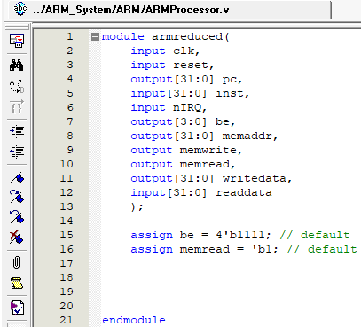
Tutorial 3
ARMProcessor.v
Don’t remove!!!
(But you can add something for timing simulation)
Your Code

Slide 50
2nd Term Project
What to submit (Total 25 points)
Project folder
RegisterFile.v (2 points)
ControlUnit.v (2 points)
Extend.v (2 points)
ALU.v (2 points)
ARMProcessor.v (15 points)
15 points will be given depending on whether the top module operates or not
Report (2 points)
Module description
If the timing simulation does not work on the board even though it works properly, please capture the timing simulation result and write it in the report
How to submit
Send a report file to kyoungmin2@naver.com
Due date: 12/6 23:59
Both Korean and English are available
Please fill in the fille name as ‘StudentNumber_Name_2ndTermProject’
Ex) 2018010594_김경민_2ndTermProject.zip

Slide 51
Q&A

